Slide 1
Simple Programming
If and Nested Statements
http://www.yahmad.co.uk/

Slide 2
Unit Overview
Objectives
Understand why computer programming scripts are used.
Understand the use of Variables as place holders for information.
Understand the use of if and nested if statements in Python Programming.
Outcomes |  | Time
Task 1 | Job Type
Task 2 | Stock Level
Task 3 | Sales Target
Task 4 | Employee Pay
Task 5 | Grades
Task 6 | Extension
http://www.yahmad.co.uk/

Slide 3
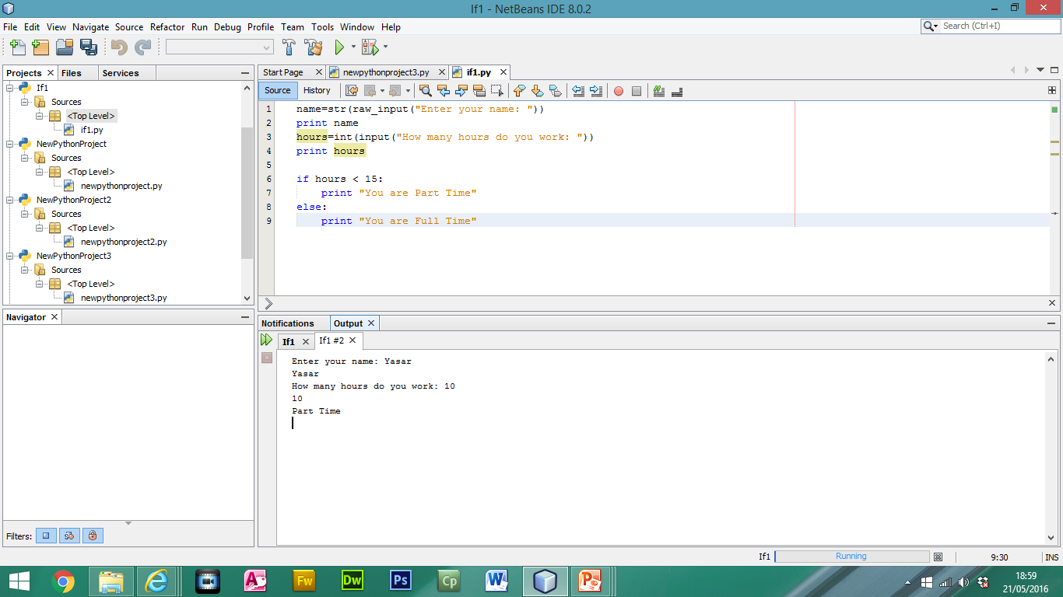
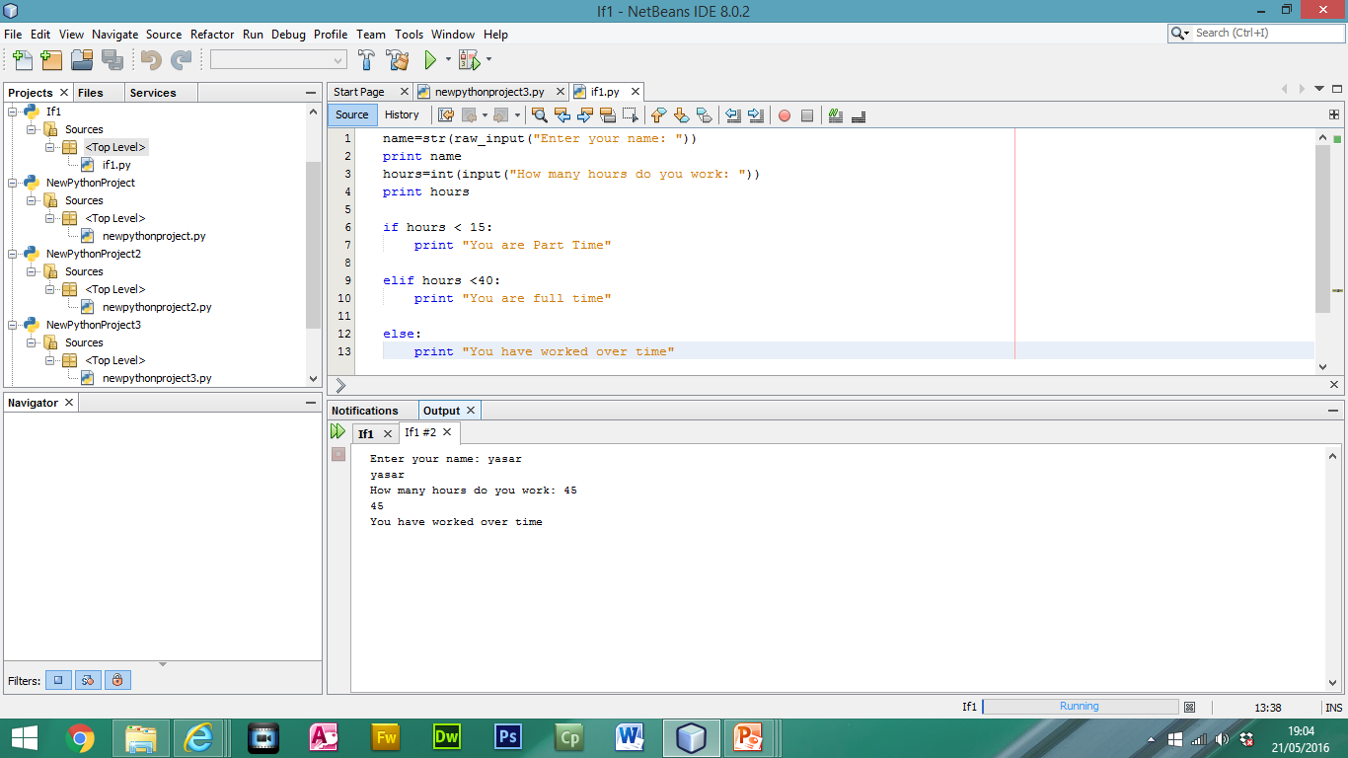
IF/Nested Overview
Simple script to work whether employees are part time or fulltime.
Logical Test: Worked Hours less than 15
True: “You are a part time employee”
False: “You are a full time employee”
Logical Test
IF Statement: True
IF Statement: False
Logical Test
1. IF Statement: True
2. IF Statement: True
IF Statement: False

Slide 4
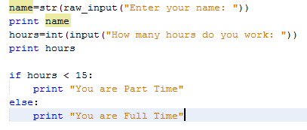
Task 1 – Job Type
Create a simple script to work whether employees are part time or fulltime.
Logical Test: Worked Hours less than 15
True: “You are a part time employee”
False: “You are a full time employee”
http://www.yahmad.co.uk/

Slide 5
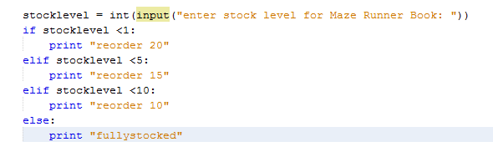
Task 2 – Stock Level
Create a simple script to work the reorder amount for the Maze Runner Book.
Logical Test: Stock Level <1, True: “reorder 20”
Logical Test: Stock Level <5, True: “reorder 15”
Logical Test: Stock Level <10, True: “reorder 10”
False: “Fully Stocked”

Slide 6
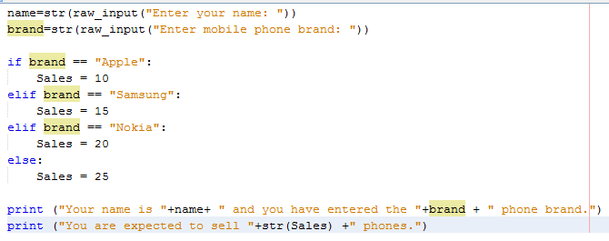
Task 3 – Sales Target
Create a simple script to work the sales target.
Logical Test: brand == Apple , True: Sales = 10
Logical Test: brand == Samsung, True: Sales = 15
Logical Test: brand == Nokia , True: Sales = 20
False: Sales = 25
http://www.yahmad.co.uk/

Slide 7
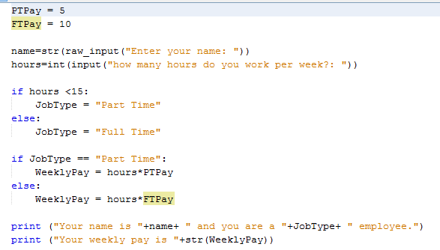
Task 4 – Employee Weekly Pay
Create a simple script to work employees weekly salary.
Job Type: Less than 15 hours (Part Time), 15 Hours or More (Full Time)
Rate of Pay: Part Time (£5), Full Time (£10)
Weekly Pay: Hours * Rate of Pay (FT or PT)
http://www.yahmad.co.uk/

Slide 8

Task 5 – Grades
Create a simple script to work out the pupils grade.
Create two variables to contain the pupils name and grade out of 100.
Checking Grade Variable
1st True Statement
>90, A* Grade
2nd True Statement
>80, A Grade
3rd True Statement
>70, B Grade
4th True Statement
>60, C Grade
5th True Statement
>50, D Grade
False: anything less than 50 - Fail
http://www.yahmad.co.uk/

Slide 9
Task 6 - Extension
Can you make your own program containing variables and If/Nested Statements?
http://www.yahmad.co.uk/

Slide 10
Plenary – Refer to the Lesson Objectives
Objectives
Understand why computer programming scripts are used.
Understand the use of Variables as place holders for information.
Understand the use of if and nested if statements in Python Programming.
Plenary Task (Q&A)
Peer assess each other scripts. Discuss the levels pupils have achieved for this task. Question: What is the purpose of If and Nested Statements?
http://www.yahmad.co.uk/

